Slide 1
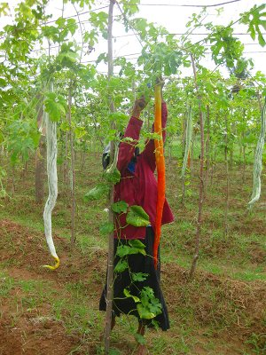
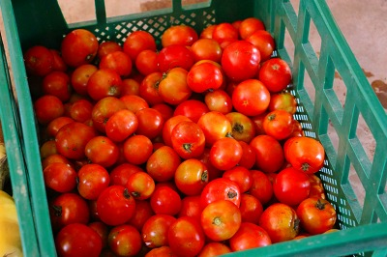
Harvest
1
GVSPP Q17

Slide 3
Harvest
2
Harvest the crops at the right timing
Half-matured (brinjal, cucumber, pumpkin, etc.)
Postharvest ripening Seed extraction
Full-matured (tomato, okra, capsicum, bitter gourd, Luffa, etc.) Seed extraction
Colour
Size
Texture
Dryness
Days from flowering/pollination
DO NOT harvest from Virus or Bacteria infected Plants

Slide 4
Harvest
2’
Crops should be harvested at the right timing to maximize the quality of harvested seeds
Some crops can be harvested at half-matured stage to fully mature by postharvest ripening
The indications of harvesting timing can be recognized by colour, size, texture, and dryness (cracking)
To know more precise harvesting timing, days from flowering or pollination date can be used
Plants that infected by virus and bacteria should not be harvested→ pathogens in high possibility translocated to the seeds

Slide 5
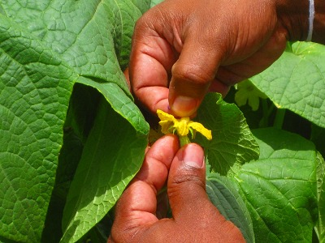
Harvest
3
Determination of harvesting timing by counting days
Indications of harvesting timing
Count the days from the date of flowering/pollination
Record flowering/pollination date
Crop | Days to harvest | Postharvest ripening
Tomato | Around 45 days | Not necessary
Brinjal | Around 50days | 10 – 20days
Capsicum | 60 – 70days | Not necessary
Cucumber | 30 – 40days | 3 – 10days
Crop | Days to harvest | Postharvest ripening
Pumpkin | 40 - 60days | Around 20days
B. gourd | Around 30days | Not necessary
Luffa | 50 – 60days | Not necessary
W. melon | 30 – 40days | 4 – 5days

Slide 6
Harvest
3’
Determine the harvesting timing by counting days from flowering/pollination
Record the date of flowering/pollination
Considering flowering/pollination date as the day 1, following day is the day 2, and so on
When counting days reach to the indicated days for the particular crops (showed in table), crops are at the right timing to harvest

Slide 7
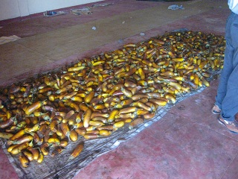
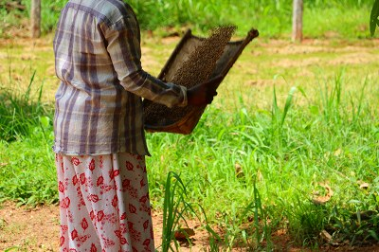
Postharvest
4
GVSPP Q18-Q21

Slide 9
Postharvest Ripening
5
Some crops can be harvested before full-mature, and let the fruits fully matured after harvesting
Advantage of postharvest ripening
Improve seed maturity
Decrease plant stress
Distribute more nutrients to other fruits
Minimize the risk of damaging fruits in field
Method of postharvest ripening
Store the fruits in well-ventilated and shady place for days after harvesting

Slide 10
Postharvest Ripening
5’
For the particular crops that can apply postharvest ripening, it is recommended to practice because;
Seed maturity is increased to improve quality
Lesser number of fruits gives less stress to the plant. Reducing plant stress as much as possible is important for the plant to stay healthily and vigorously
By reducing the number of fruit from the plant, other remained fruits can get more nutrients to improve fruit/seed quality
Risks of damaging fruits (by disease, pest, wild animals, or natural disaster) increase as the fruits stay in field for longer period. Earlier harvest helps reducing the risks of damaging the fruits
After harvesting, the fruits should be stored in well-ventilated and shady place for several days. Postharvest ripening period varies in crops

Slide 11
Effect of Postharvest Ripening
6
Germination Rate with different harvest and postharvest ripening days
Brinjal
Cucumber
Source: Suzuki (1964)
Harvesting days after flowering | Days of postharvest ripening
 | 0 | 5 | 10 | 15 | 20
50 | 34.0% | 58.8% | 99.8% | 97.0% | 99.5%
60 | 96.2% | 95.3% | 99.9%
70 | 99.5%
Source: TBIC (2012)
Harvesting days after flowering | Days of postharvest ripening
 | 0 | 10 | 20
20 | 10.0% | 67.5% | 76.8%
30 | 92.5% | 95.0% | 100%
40 | 97.5% | 95.0% | 85%

Slide 12
Effect of Postharvest Ripening
6’
Data in the tables is results of studies on postharvest ripening on brinjal and cucumber
The results show that there is no difference in seed germination between harvested at fully matured stage and earlier harvested and compensate days by postharvest ripening
By practicing postharvest ripening, fruits can be harvested not until waiting for fully matured in field without having seed germination problem
Brinjal:
Germination rate of Fully matured (harvested at 70days) brinjal = 99.5%
Harvested at 50days and having postharvest ripening for 20days =99.5% (50+20=70days)
Harvested at 60days and having postharvest ripening for 10days =99.9% (60+10=70days)

Slide 13
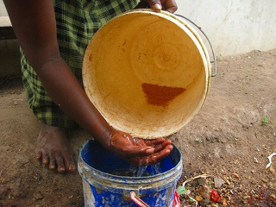
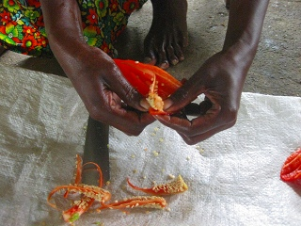
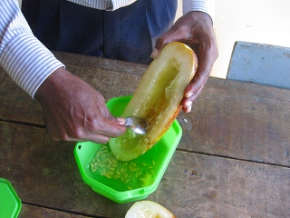
Seed Extraction
7
Seeds should be extracted properly not to damage the seeds
Some crops require washing with water for seed extraction (tomato, brinjal, cucumber, etc.). But do not wash the crops not requiring washing (Capsicum, Luffa, Okra, etc.)

Slide 14
Seed Extraction
7’
Handle with care not to damage the seeds when extract the seed from fruits
Some crops need fermentation period (tomato, cucumber), some crops need water to extract seeds(brinjal), and some crops need to wash with water to clean the seeds (bitter gourd, snake gourd) when extracted. Such crops are okay to use water but avoid using for the crops that unnecessary to wash (capsicum, okra, luffa)
Seeds to contacting water may decrease seed germination or degrade seed appearance
See the technical manual for seed extraction methods for each crop

Slide 15
Drying
8
Drying of seed is a very important procedure that influencing the seed quality greatly
Seed has to be dried as soon as it can to prevent decreasing seed germination
How?
Spread seeds evenly on a mat under the sun to dry moisture from seed surface
Avoid exposing seeds under direct sunlight when irradiation is too strong(11am-2pm)
Turn over seeds constantly to dry uniformly
After drying seed surface, further dry them in shade (dry in well-ventilated place. Avoid high temperature and humidity place)

Slide 16
Drying
8’
Drying of seed is a very important procedure that influencing the seed quality greatly
Seed has to be dried as soon as it can to prevent decreasing seed germination
How?
Spread seeds evenly on a mat under the sun to dry moisture from seed surface
Avoid exposing seeds under direct sunlight when irradiation is too strong(11am-2pm)
Turn over seeds constantly to dry uniformly
After drying seed surface, further dry them in shade (dry in well-ventilated place. Avoid high temperature and humidity place)

Slide 17
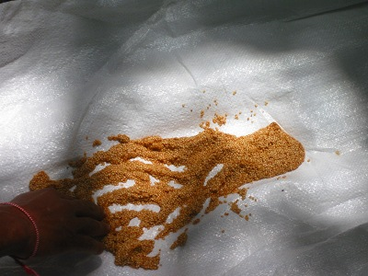
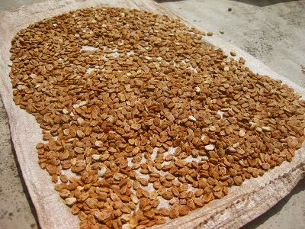
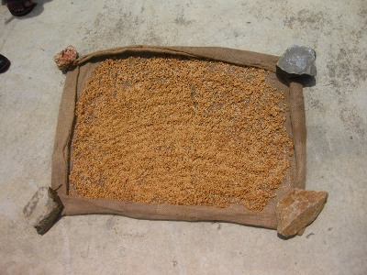
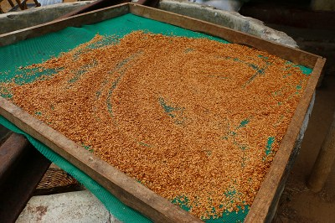
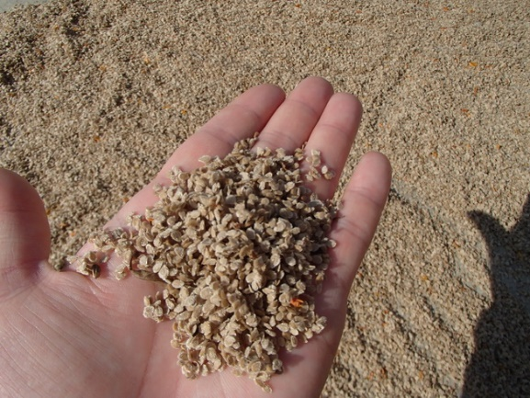
Drying
9
×
Dry wet seeds
as soon as possible
Spread seeds evenly. Try not seeds lie on top of each other
Do not dry seeds directly on concrete or on soil
✓
✓
Place seeds on a mat to buffer heat from bottom
Better to dry seeds apart from the ground
Turn over seeds
to dry uniformly

Slide 18
Drying
9’
Dry wet seed as soon as possible not to seed to absorb water
Seeds should be spread evenly. If seeds lie on top of the each other, seeds cannot be dried uniformly
Avoid drying seeds directly on concrete. Seeds are heated up from the bottom as concrete heated up by sunlight. Place a mat or something between seeds and ground to buffer heat up the seeds
It is better to place seeds at higher place from the ground where heat from the bottom can be buffered

Slide 19
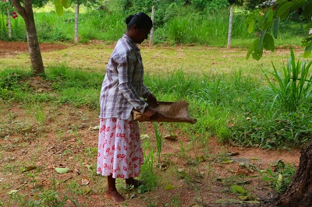
Cleaning
10
Cleaning is to remove dust from the seeds
Improve physical seed appearance
Prevent seeds to absorb moisture
How?
Winnowing
Sieving
Washing with water

Slide 20
Cleaning
10’
Cleaning is to remove dust attach to the seeds
By doing seed cleaning, it improves seed physical appearance to help increasing commercial value
Moisture is a great enemy to seeds to maintain seed quality. Dust attach to the seeds helps absorbing moisture in air to increase seed moisture. Seeds without dust absorbs less moisture from air
Winnowing, sieving, washing are the ways to clean the seeds

Slide 21
Storing
11
Avoid storing seeds in a high humidity and temperature condition
Germination rate of tomato seeds at 372days after storing under different conditions
Source: Barton (1941)
Relative Humidity (RH) | Air Temperature
 | 5℃ | 10℃ | 20℃ | 30℃
35% | 94% | 91% | 90% | 91%
55% | 90% | 89% | 89% | 83%
76% | 88% | 76% | 45% | 0%

Slide 22
Storing
11’
Seeds should be stored in low humidity and low temperature condition
Humidity and temperature influence the quality of seeds, especially seed germination
As it’s shown in the table, tomato seeds that stored under low humidity and low temperature have high germination rate even after storing for a year
On the other hand, tomato seeds that stored under high humidity and high temperature performed worst in germination

Slide 23
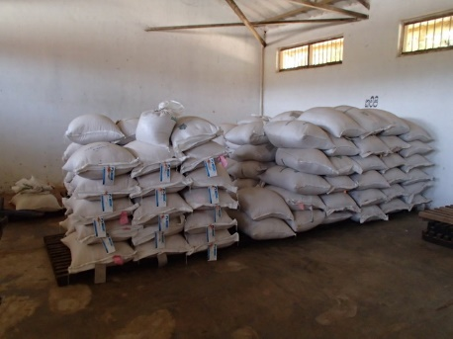
Storing
12
Pile seed bags on wooden pallet or shelf
Pile seed bags keeping distance from the ground and wall as much as possible
Bagging Material:
Jute/fabric bag highly prevents seeds from moisture
Double layer plastic bag prevents more moisture than single layer plastic bag

Slide 24
Storing
12’
Avoid piling seed bags directly on the ground (floor). Seed bags should be piled on wooden pallet or shelf to prevent moisture to percolate from the ground
Due to the temperature gap between day and night, walls of a building sometimes get wet by dew condensation. Direct contact of seed bags to the walls should be avoided
Seeds should be stored in bags. Jute/fabric bag prevents seeds from moisture to a large degree
If a plastic bag is used for bagging, better to make it double layer to protect seed from moisture
Older seeds cause seed quality to deteriorate quicker than fresher seeds. The old seeds should be discarded and renewed the seed stock periodically

